Slide 1



OIL WELL MONITORING SYSTEM (E.E.C.S. TEAM)
3rd Annual Progress Energy
Senior Design Symposium
Presented By:-
Louis Bengtson - Software
Kaleb Stunkard - Input
Jimit Shah - Output

Slide 2
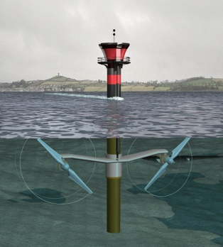
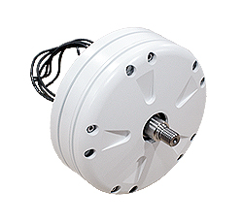
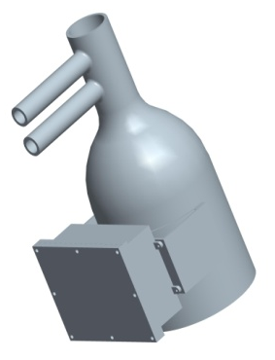
System Flow Chart
Turbine
Generator
INPUT
SIGNAL
CONVERTERS
PROCESSOR
Sensor
BATTERY
Electrical System

Slide 3
GOALS & OBJECTIVES
Convert wave energy to electrical energy by means of a generator.
Produce usable energy for the sensors.
Must be enclosed in a waterproof container.
Must be suitable for conditions that are present in the Gulf of Mexico.

Slide 4
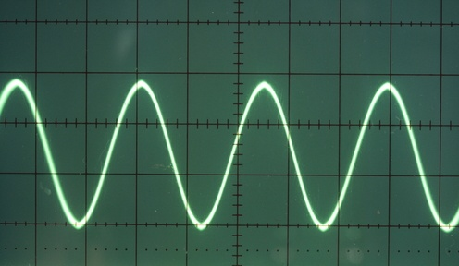
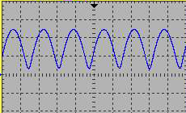
GENERATOR SIGNAL
INPUT CIRCUIT
RECTIFIED SIGNAL

Slide 5

SIGNAL
CONVERTERS
12 V steady output
Sensor
BATTERY

Slide 6
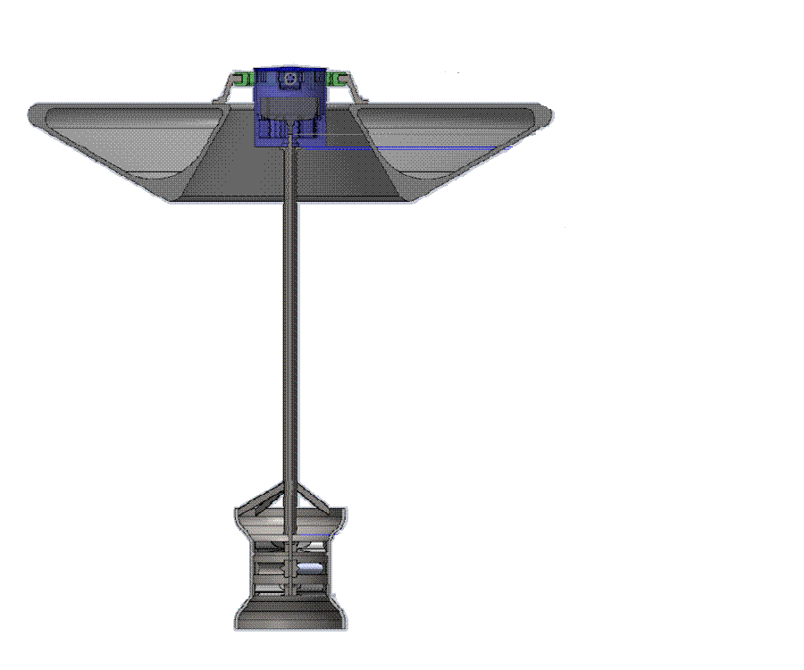
Electrical Unit
Buoy
Turbine

Slide 7
Product and End Results
An electrical unit was built in order to power up the sensors.
The product uses wide input and a constant output to the battery.
It will be suitable in sea and surface conditions.
The software used in this product will help make the system efficient.
In the end, this product will be able to produce usable electrical energy.

Slide 8

Thank You ACKNOWLEDGEMENTS Dr. Samuel Richie Dr. Zhihua Qu Carlos Velez

